Slide 1
The Need for PageSpeed

Slide 2
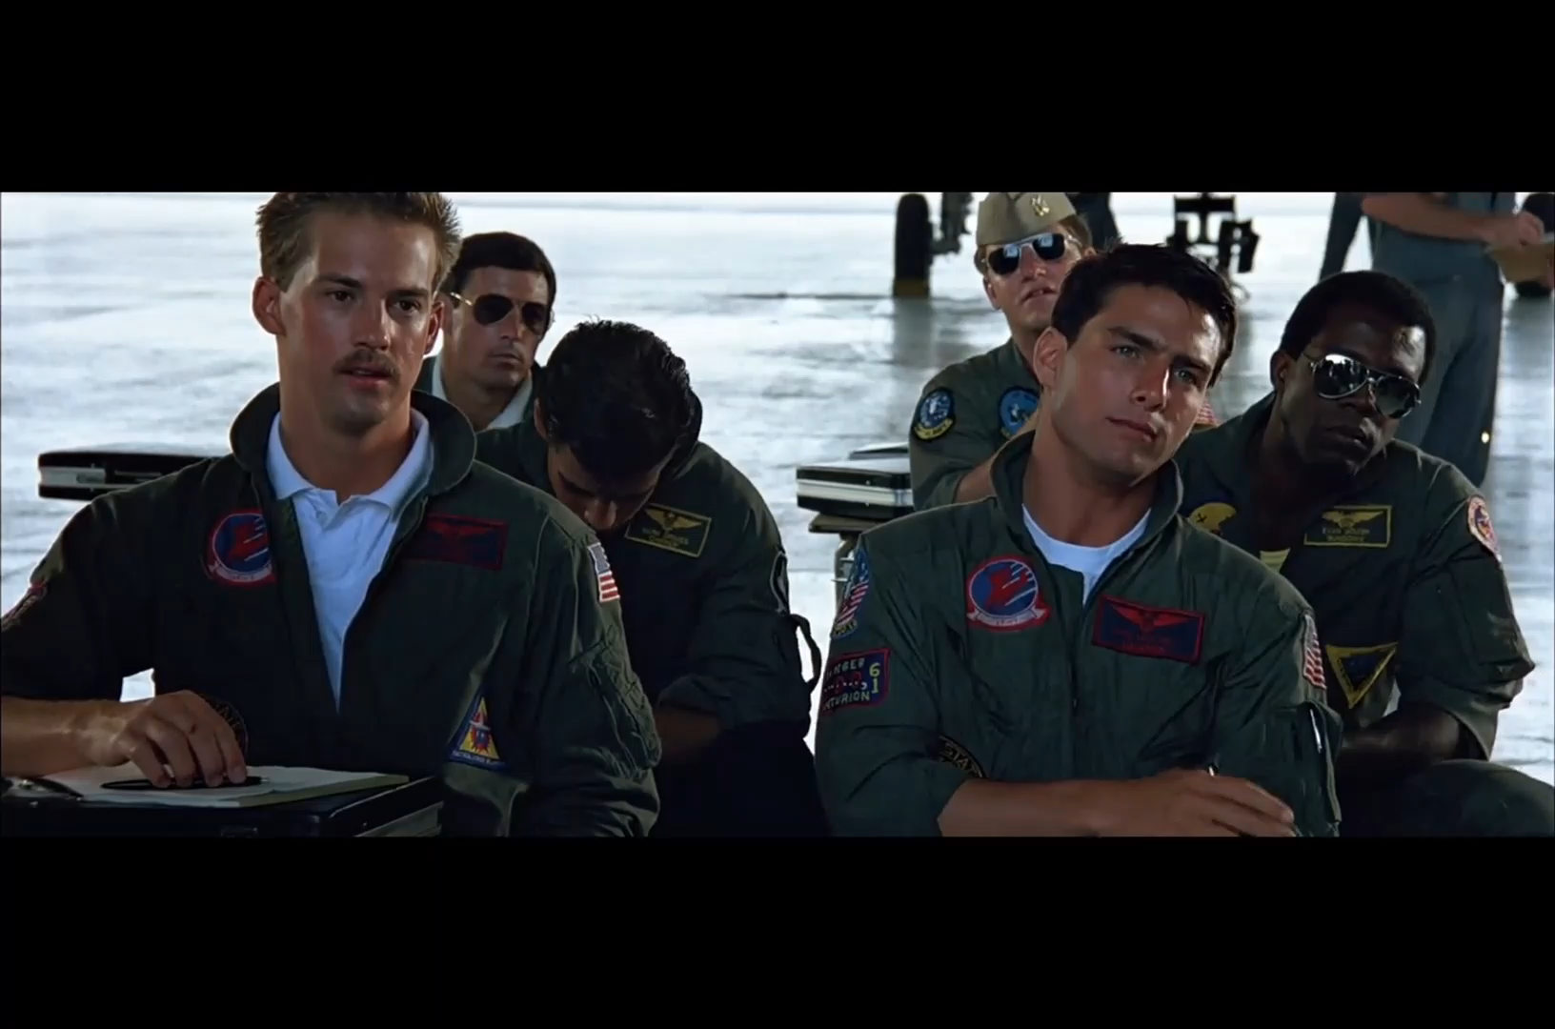
If you know the enemy [your customer] and know yourself, you need not fear the result of a hundred battles – Sun Tzu
Notes:
Know your customers – do they need the additional functionality or are they on a dodgy connection?

Slide 3
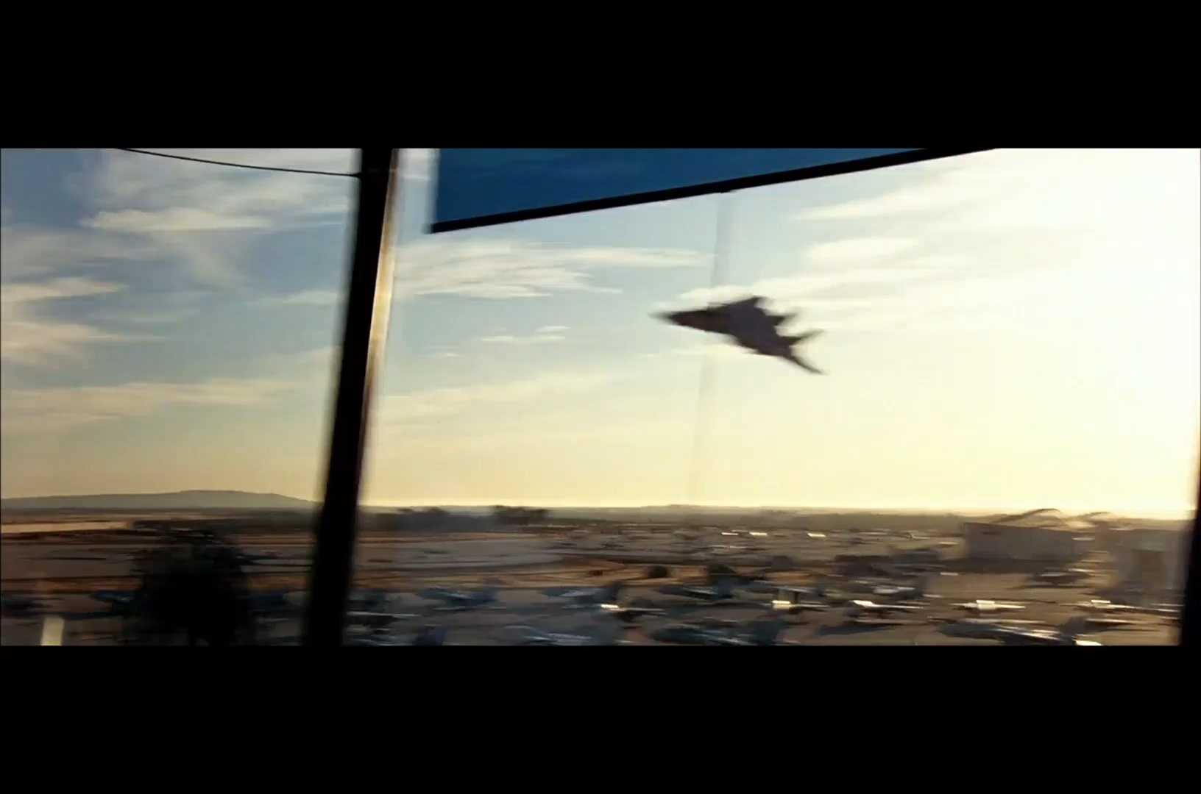
Negative Ghost Rider, the pattern is full
Notes:
Render blocking JavaScript

